Slide 1
Introduction to PL/SQL Programing
Lecture 6

Slide 2
Agenda
Basic code blocks (unnamed procedures),
Variable declaration and anchor data types,
Substitution variables,
Date and other supplied functions,
Sequences,
Synonyms, and
Abstract data types

Slide 3
What is PL/SQL
Oracle’s extensions to SQL
Procedural in nature
Allow you to write code blocks
Add additional extensions to SQL to
Fill in deficiencies
Add improvements
Anything that is not “Standard SQL” is PL/SQL

Slide 4
Code Blocks
Allow you to execute an anonymous or unnamed procedure.
Unnamed procedures are stored as an SQL file.
Stored procedures are stored in the database catalog.

Slide 5
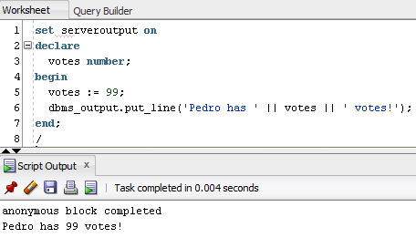
Anatomy of a Code Block

Slide 6
Substitution variables
Prompt for a value inside a code block.
Replace or substitute that value for the variable before the code block is executed.

Slide 7
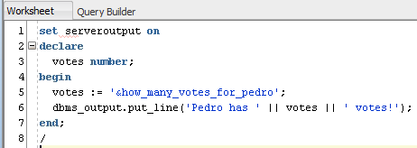
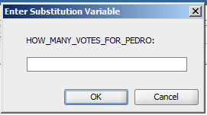
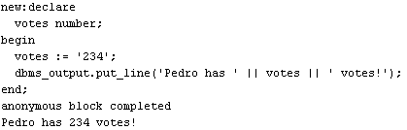
Substitution Variables
234

Slide 8
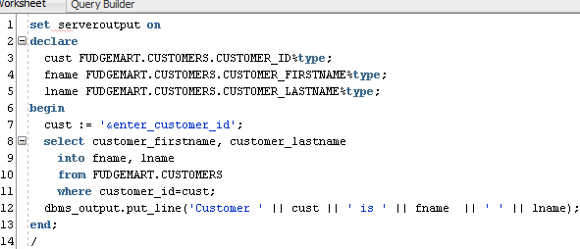
Anchor Data Types
When you want a variable’s type to match that of a table column.

Slide 9
Demo !!!
I’ll write some simple PL/SQL Programs
- Hello World
- Lookup Customer Info

Slide 10
Other PL/SQL constructs
PL/SQL

Slide 11
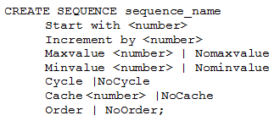
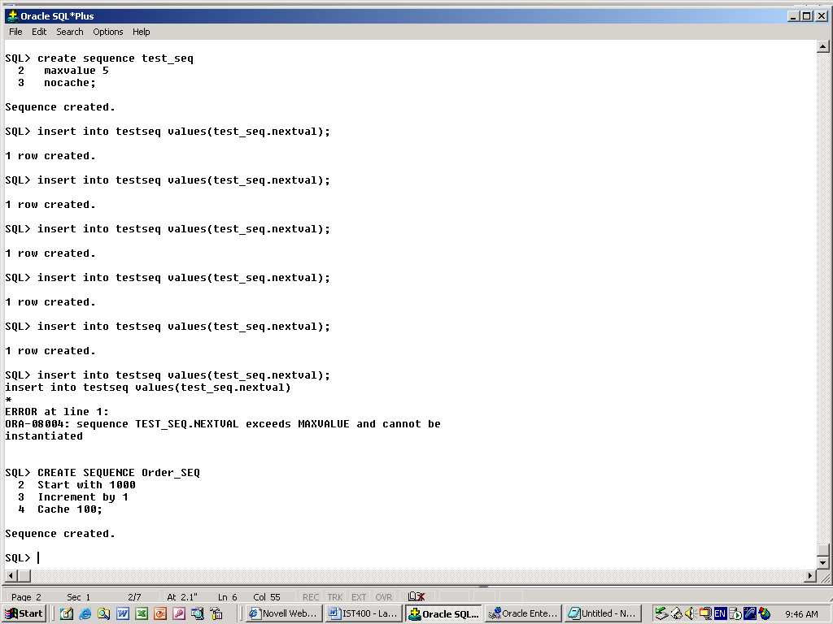
Sequences
Like int identity, but not tied to a column or table. Global in nature
Order_SEQ.Currval ➔ Get current value
Order_SEQ.Nextval ➔ Next value

Slide 12

Synonyms
Create alternate names for existing database objects.

Slide 13
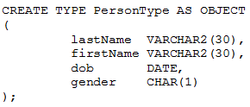
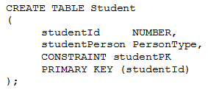
Abstract Data Types
Like a table, but used as a type.
Simplifies table complexity w/o joins.

Slide 14

Questions
?

